Slide 1






Green Stack
By Apaichon Punopas

Slide 2
Course Outline Day 1
Mongo DB
Introduction of NoSQL and MongoDB.
MongoDB and Administration Tools Installation.
CRUD Command. (Create, Read, Update, Delete)
----------------------------------Break-----------------------------------
Document Validator
Query with Condition
-----------------------------------Launch --------------------------------
Node JS + Express
Introduction of NodeJS and Express
NodeJS Installation
Javascript ES6
-----------------------------------Break -----------------------------------
Rest API
Integrate Rest API with MongoDB

Slide 3
Course Outline Day 2
VueJS
Introduction of VueJS.
VueJS Cli Installation.
Component Thinking
----------------------------------Break-----------------------------------
State Management with Vuex
Get , Add , Edit , Remove
-----------------------------------Launch --------------------------------
Vue + Rest Api
Integrate Rest Api for create data.
Integrate Rest Api for update data.
Integrate Rest Api for delete data.
-----------------------------------Break -----------------------------------
Integrate Rest Api for find data.
Integrate Basic Security
Vue Router

Slide 4

Introduction of VueJS
Vue pronouces like View. It is a progressive framework for building user interfaces.

Slide 5
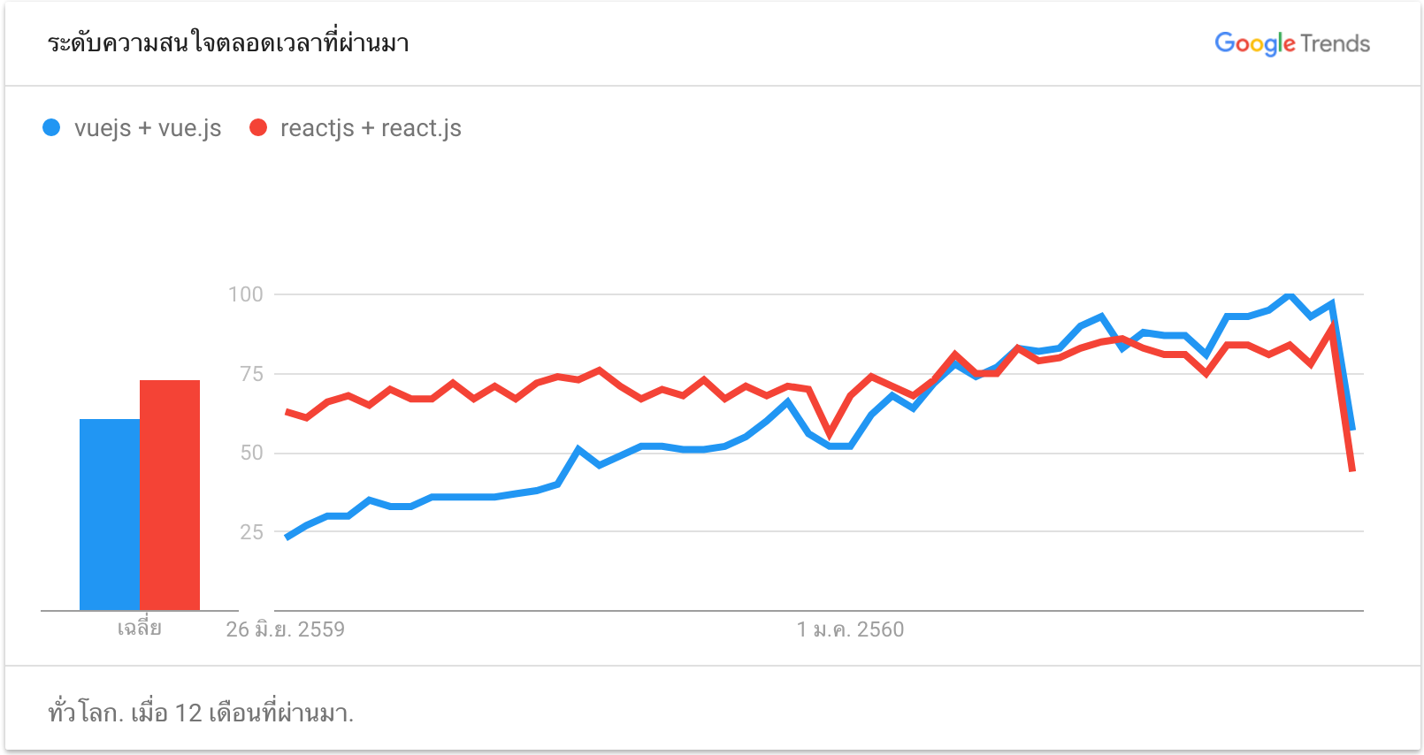
Interested Statistic from Google Trends

Slide 6
Why Is Vue.js So Popular?
It’s quick. Vue.js core team built a sample project that renders 10 000 list items 100 times. On average, Vue.js was almost 2 times faster than React (51ms vs. 94ms).
It’s reactive. Taking best features from React, Vue.js offers a VirtualDOM that watches for changes and re-renders only the parts that need to be re-rendered.
It’s well-documented.
It’s flexible and offers libraries.
It uses DevTools.
Credit by : https://10clouds.com/blog/vuejs-angular-react/

Slide 7
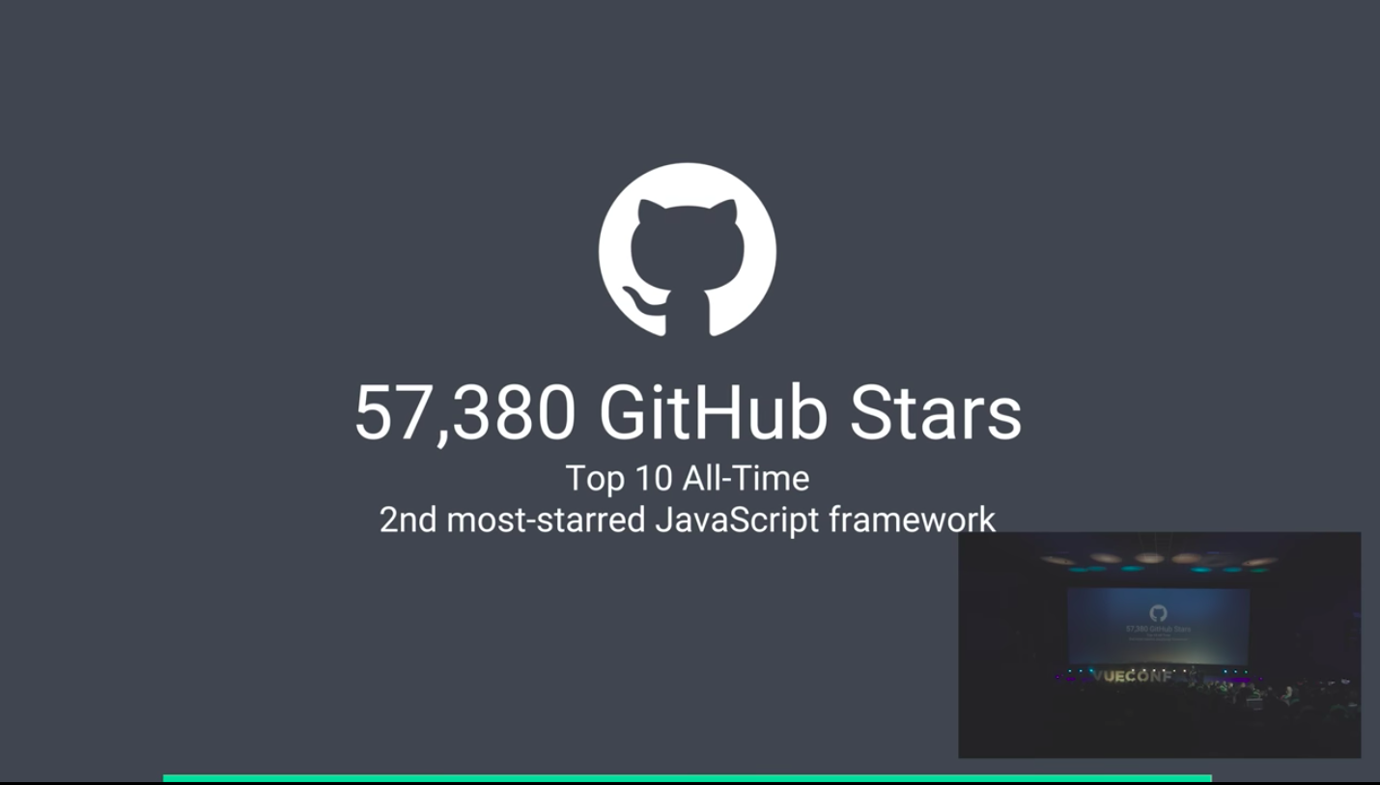

Slide 8
Why Is Vue.js So Popular?
It utilises ES6 features, Webpack, and a reliable CLI project generator. Thanks to a good CLI (vue-cli).
It relies on a component-based approach.
It supports hot reloading.
Courses and tutorials. You can find a few good Vue.js courses on Udemy
Credit by : https://10clouds.com/blog/vuejs-angular-react/

Slide 9
Why Is Vue.js So Popular?
It utilises ES6 features, Webpack, and a reliable CLI project generator. Thanks to a good CLI (vue-cli).
It relies on a component-based approach.
It supports hot reloading.
Courses and tutorials. You can find a few good Vue.js courses on Udemy
Credit by : https://10clouds.com/blog/vuejs-angular-react/

Slide 10
Who Uses Vue.js?
Facebook
Xiaomi
Alibaba (on some of its landing pages)
WizzAir
EuroNews
Grammarly
Gitlab
Laracasts
Credit by : https://10clouds.com/blog/vuejs-angular-react/

Slide 11
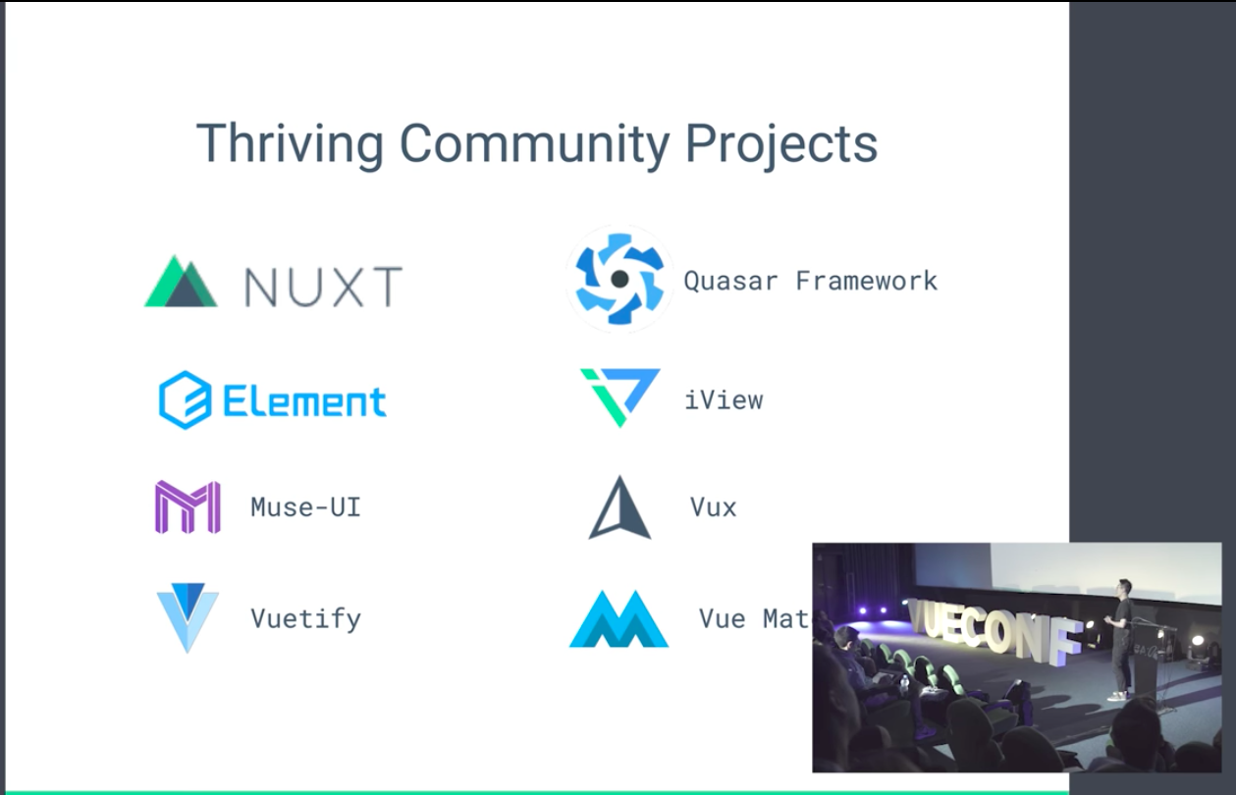

Slide 12
VueJS Cli Installation
Open Terminal
# install vue-cli $ npm install --global vue-cli # create a new project using the "webpack" template $ vue init webpack my-project # install dependencies and go! $ cd my-project $ npm install $ npm run dev

Slide 13
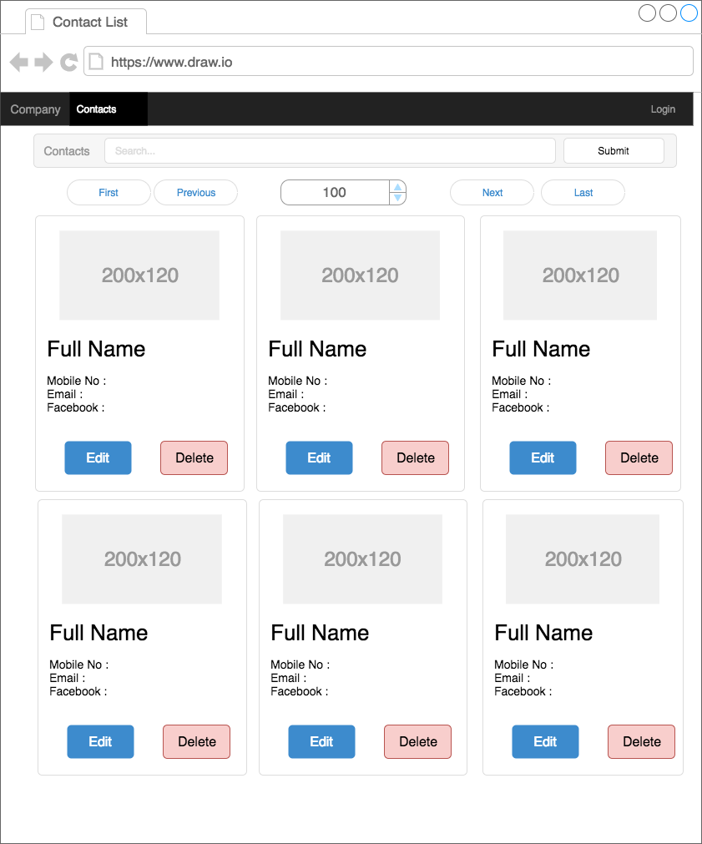
Component Thinking
Reusable
Maintainable
Platform independent
Encapsulation mechanism

Slide 14
Component Thinking
Menu Bar
Search Panel
Data Pager
Card Item
Contacts Page
Card List

Slide 15
Install other libraries
semantic-ui-css
jquery
vuex
mongodb
axios
$ npm install semantic-ui-css jquery vuex mongodb axios --save

Slide 16
Use Semantic UI
src/main.js
import Vue from 'vue'
import App from './App'
import router from './router'
import '../node_modules/semantic-ui-css/semantic.min.css'
Vue.config.productionTip = false
Add code here
https://semantic-ui.com/

Slide 17
Create a menubar component
src/components/MenuBar.vue
<template>
<div class="ui stackable menu inverted">
<div class="item">
<img src="../assets/logo.png">
</div>
<a class="item">Contacts</a>
<div class="right menu">
<div class="item">
<div class="ui primary button">Login</div>
</div>
</div>
</div>
</template>

Slide 18
Create a menubar component
src/components/MenuBar.vue
<template>
...
</template>
<script>
export default {
name: 'menubar',
data () {
return {
msg: 'Welcome to Menu Bar'
}
}
}
</script>

Slide 19
Setup Webpack to available jQuery
build/webpack.dev.conf.js
module.exports = merge(baseWebpackConfig, {
module: {
rules: utils.styleLoaders({ sourceMap: config.dev.cssSourceMap })
},
// cheap-module-eval-source-map is faster for development
devtool: '#cheap-module-eval-source-map',
plugins: [
new webpack.ProvidePlugin({
$: "jquery",
"jQuery": "jquery",
"window.jQuery": "jquery",
semantic: 'semantic-ui-css',
Semantic: 'semantic-ui-css',
'semantic-ui': 'semantic-ui-css'
})

Slide 20
Add menubar in App.vue for use every pages.
src/App.vue
<template>
<div id="app">
<menubar> </menubar>
<router-view></router-view>
</div>
</template>
<script>
import semantic from '../node_modules/semantic-ui-css'
import menubar from './components/MenuBar'
export default {
name: 'app',
components: { semantic, menubar }
}
</script>
setup component tag like html
3
import to reuse component
1
register component in scope
2

Slide 21
Main parts of component
Template
Vue.js uses an HTML-based template syntax that allows you to declaratively bind the rendered DOM to the underlying Vue instance’s data. All Vue.js templates are valid HTML that can be parsed by spec-compliant browsers and HTML parsers.
Script
Vue.js uses an JavaScript to program the behavior of component.
Style
Vue.js uses an CSS to specify the layout of component

Slide 22
Create a search panel component
src/components/SearchPanel.vue
<template>
<div class="ui teal center aligned segment">
<div class="ui fluid action input">
<a class="ui teal ribbon label">
<h4>Contacts</h4>
</a>
<input type="text" placeholder="Search...">
<div class="ui button">Search</div>
</div>
</div>
</template>

Slide 23
Create a search panel component
<template>
...
</template>
<script>
export default {
name: 'searchpanel',
data () {
return {
msg: 'Welcome to Search Panel'
}
}
}
</script>

Slide 24
Create the Contacts page
src/pages/Contacts.vue
<template>
<div class="ui center aligned segment">
<searchpanel></searchpanel>
</div>
</template>
<script>
import searchpanel from '@/components/SearchPanel'
export default {
name: 'contacts',
components: {searchpanel}
}
</script>

Slide 25
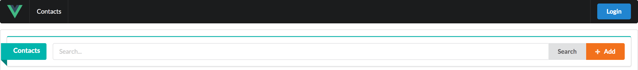
Create the Contacts page
src/pages/Contacts.vue

Slide 26
Create a data pager component
src/components/DataPager.vue
<template>
<div class="ui center aligned segment">
<button class="ui basic button">
<i class="angle double left icon"></i> First
</button>
<button class="ui basic button">
<i class="angle left icon"></i> Previous
</button>
<div class="ui input">
<input type="number" class="ui center aligned segment"></input>
</div>
...
</template>
2

Slide 27
Create a data pager component
<template>
<div class="ui center aligned segment">
...
<button class="ui basic button"> Next
<i class="angle right icon"></i>
</button>
<button class="ui basic button"> Last
<i class="angle double right icon"></i>
</button>
</div>
</template>
2

Slide 28
Create a data pager component
<script>
export default {
name: 'datapager',
data () {
return {
msg: 'Welcome to Data Pager'
}
}
}
</script>

Slide 29
Create a card item component
/components/CardItem.vue
<template>
<div class="ui card">
<div class="image">
<img :src="item.imageUrl" />
</div>
<div class="content">
<a class="header">{{item.firstName + ' ' + item.lastName }}</a>
<div class="meta">
<span class="date">Mobile : {{item.mobileNo}} </span>
</div>
<div class="meta">
<span class="date">Email : {{item.email}}</span>
</div>
<div class="meta">
<span class="date">Facebook : {{item.facebook}} </span>
</div>
</div>
...
2

Slide 30
Create a card item component
2
...
<div class="extra content">
<button class="ui icon blue button">
<i class="edit icon"></i>
</button>
<button class="ui icon red button">
<i class="erase icon"></i>
</button>
</div>
</div>
</template>

Slide 31
Create a card item component
<script>
export default {
name: 'carditem',
props: ['item'],
data () {
return {
msg: 'Welcome to Card Item'
}
}
}
</script>

Slide 32
Create a card list component
/components/CardList
<template>
<div class="ui four stackable cards">
<carditem v-for="a in items" :item="a" :key="a.id"> </carditem>
</div>
</template>
<script>
import carditem from '@/components/CardItem'
export default {
name: 'cardlist',
components: {carditem},
data () {
return {
msg: 'Welcome to Card List',
...
2

Slide 33
Create a card list component
2
...
items: [
{
'firstName': 'Kristy',
'lastName': 'Chung',
'mobileNo': '099-000-1234',
'email': 'kristy@vuejs.com',
'facebook': 'https://facebook.com/kristy',
'imageUrl': './static/images/kristy.png'
}
]
}
}
}
</script>

Slide 34
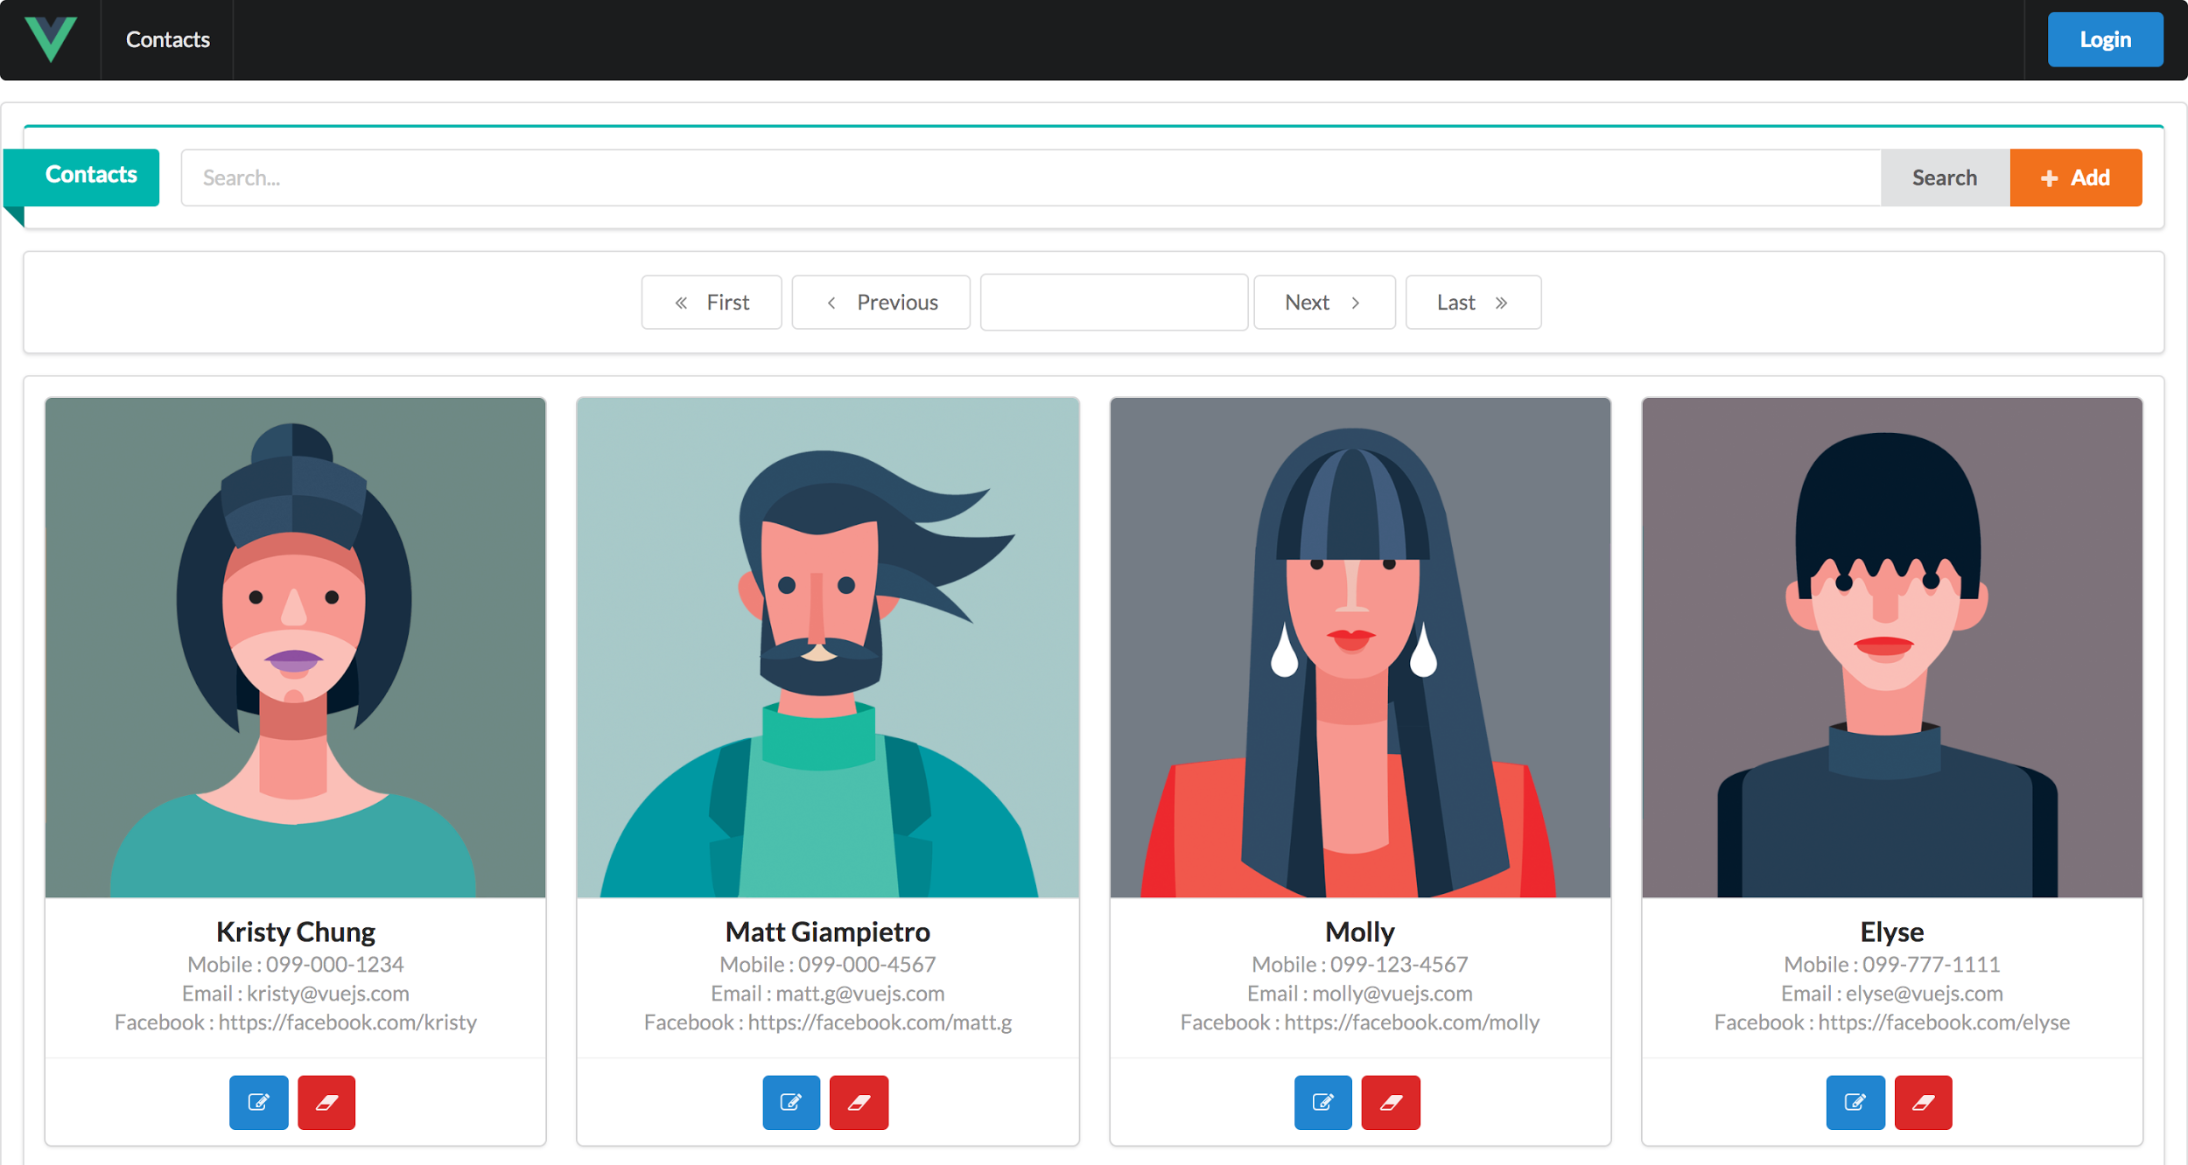
Add all components to the Contacts page
<template>
<div class="ui center aligned segment">
<searchpanel></searchpanel>
<datapager></datapager>
<div class ="ui center aligned segment">
<cardlist></cardlist>
</div>
</div>
</template>
<script>
import searchpanel from '@/components/SearchPanel'
import datapager from '@/components/DataPager'
import cardlist from '@/components/CardList'
export default {
name: 'contacts',
components: {searchpanel, datapager, cardlist}
}
</script>

Slide 35
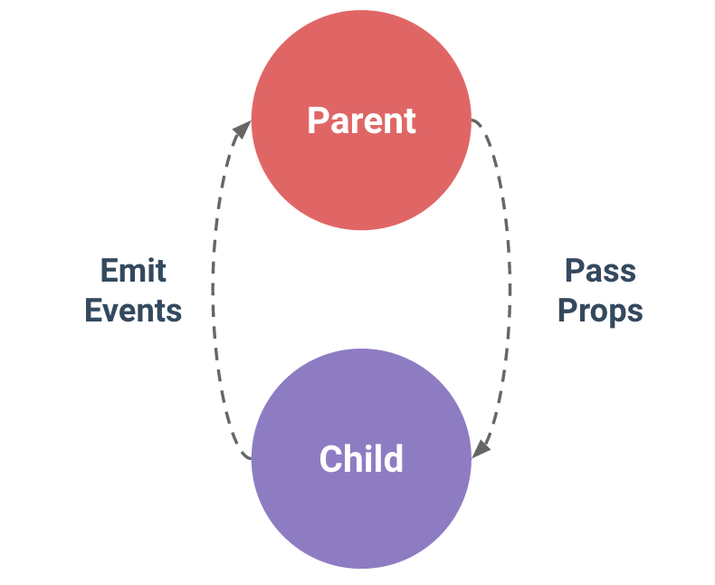
Props
Every component instance has its own isolated scope. This means you cannot (and should not) directly reference parent data in a child component’s template. Data can be passed down to child components using props.
export default {
name: 'carditem',
props: ['item'],
<div class="ui four stackable cards">
<carditem v-for="a in items" :item="a" > </carditem>
</div>

Slide 36
Be Careful using of Props
src/pages/Contacts.vue
<template>
<div class="ui center aligned segment">
...
<carditem :item="item"></carditem>
<carditem :item="item"></carditem>
</div>
</div>
</template>
<script>
...
import carditem from '@/components/CardItem'
export default {
name: 'contacts',
components: {searchpanel, datapager, cardlist, carditem},
...
2

Slide 37
Be Careful using of Props
src/pages/Contacts.vue
...
data () {
return {
item: {
'firstName': 'Steve',
'lastName': 'Jobes',
'mobileNo': '099-999-9999',
'email': 'steve.j@vuejs.com',
'facebook': 'https://facebook.com/matt.g',
'imageUrl': './static/images/steve.jpg'
}
}
}
}
</script>
2

Slide 38
Be Careful using of Props
src/components/CardItem.vue
<template>
...
<div class="extra content">
<button class="ui icon blue button" @click="changeItem()">
<i class="edit icon"></i>
...
</template>

Slide 39
Be Careful using of Props
src/components/CardItem.vue
<script>
export default {
...,
methods: {
changeItem () {
this.item = {
'firstName': 'Steve2',
'lastName': 'Jobes2',
'mobileNo': '099-999-9999',
'email': 'steve.j2@vuejs.com',
'facebook': 'https://facebook.com/steve.j',
'imageUrl': './static/images/steve.jpg'
}
}
}
...
</script>

Slide 40
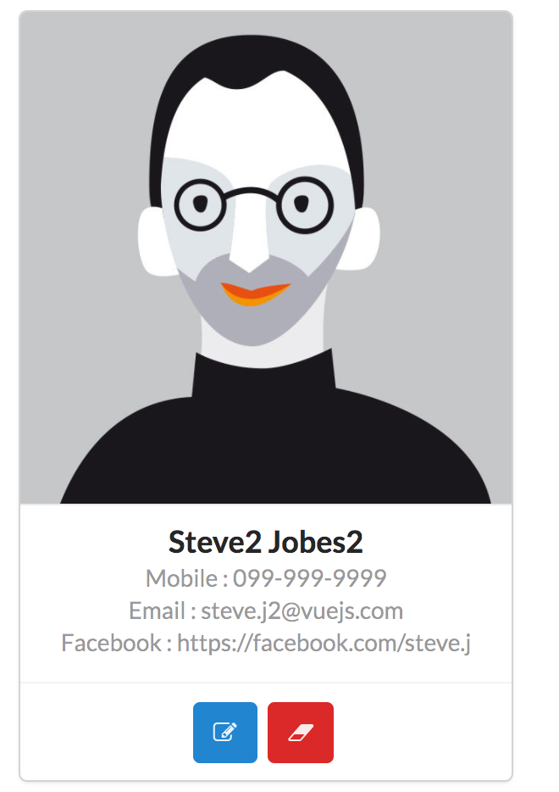
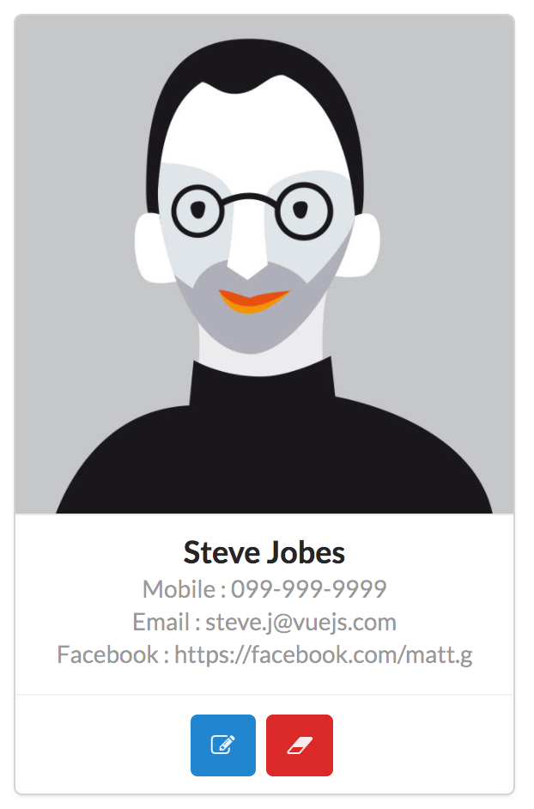
Disadvantage of Props
When changing data within the Props with the internal function of the component, the data referenced by the parent is not modified. To determine how the application design. Looking for a replacement for every component that each component applies to must be managed by the State.

Slide 41
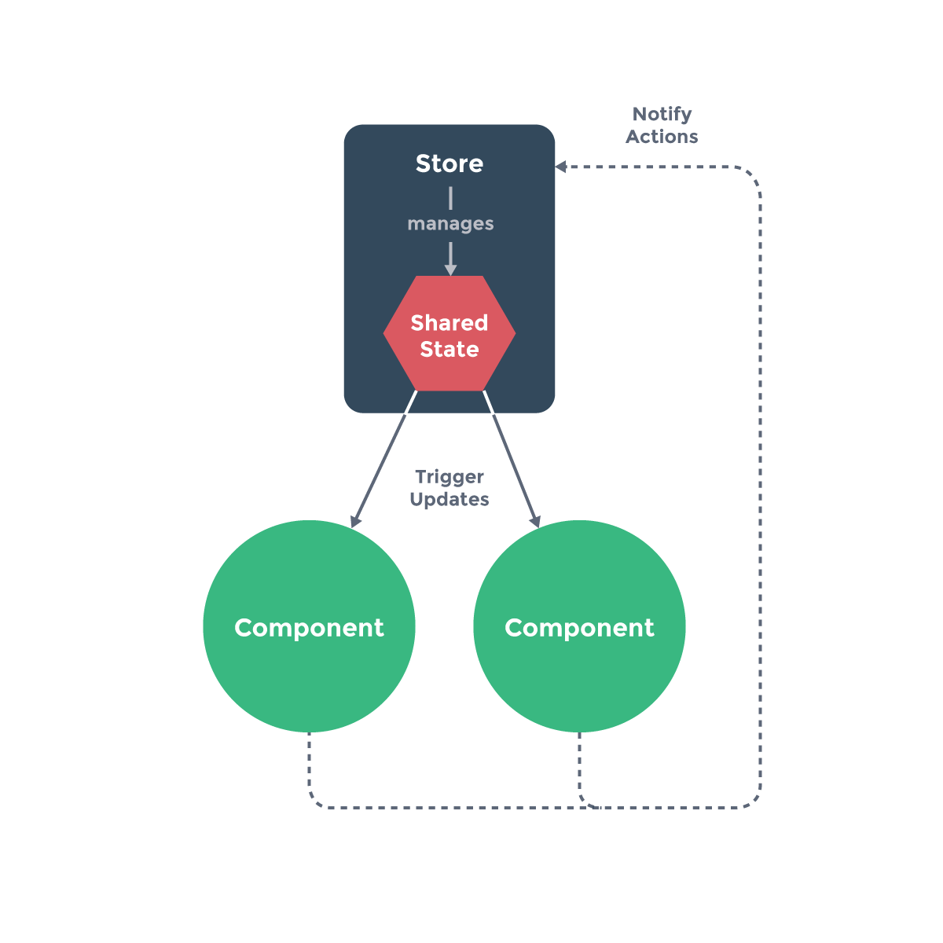
State Management
It serves as a centralized store for all the components in an application, with rules ensuring that the state can only be mutated in a predictable fashion.

Slide 42
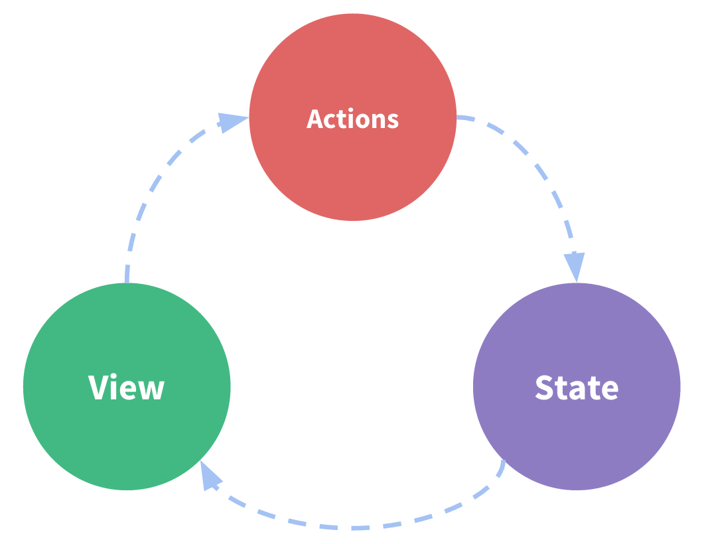
State Management
Core Concept
It is a self-contained app with the following parts:
The state, which is the source of truth that drives our app;
The view, which is just a declarative mapping of the state;
The actions, which are the possible ways the state could change
in reaction to user inputs from the view.

Slide 43
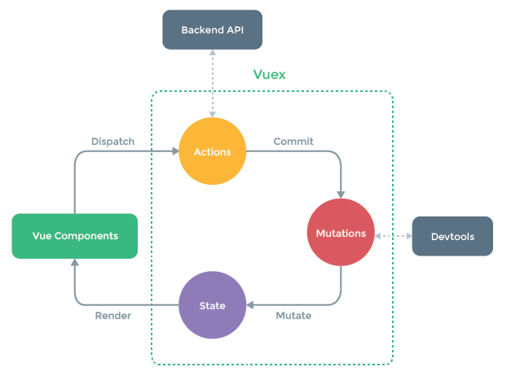
State Management

Slide 44
State Management with VueX
Create src/stores/Contacts.js
import Vue from 'vue'
import Vuex from 'vuex'
Vue.use(Vuex)
export default new Vuex.Store({
state: {
contact: {},
contacts: [
...
2
...
{
'firstName': 'Kristy',
'lastName': 'Chung',
'mobileNo': '099-000-1234',
'email': 'kristy@vuejs.com',
'facebook': 'https://facebook.com/kristy',
'imageUrl': './static/images/kristy.png'
}
]
},
getters: {
contacts: state => state.contacts
}
})
2

Slide 45
State Management with VueX
Create src/components/CardList.vue
<script>
import carditem from '@/components/CardItem'
export default {
name: 'cardlist',
components: {carditem},
props: ['items'],
data () {
return {
msg: 'Welcome to Card List'
}
}
}
</script>

Slide 46
State Management with VueX
Create src/pages/Contacts.vue
<template>
...
<cardlist :items="items"></cardlist>
...
</template>
<script>
...
import contactsStore from '@/stores/Contacts'
export default {
...
mounted () {
this.items = contactsStore.getters.contacts
},
...
...
data () {
return {
items: []
}
}
}
</script>
2
2

Slide 47
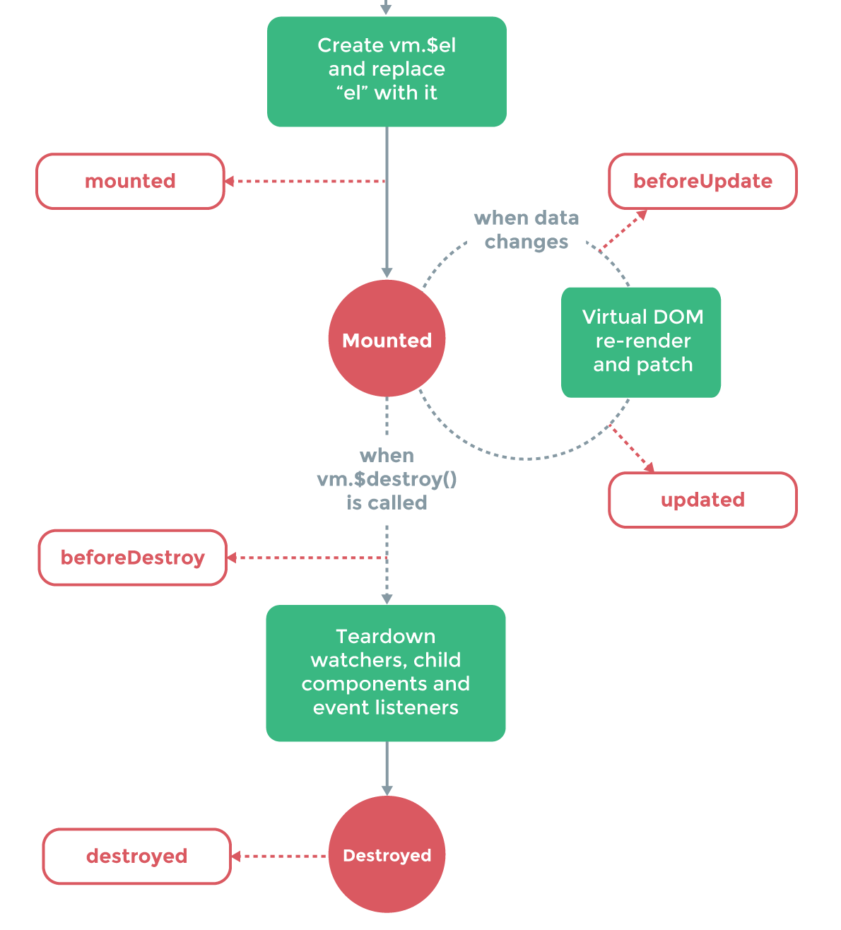
VueJS Life cycle mounted
https://vuejs.org/v2/guide/instance.html#Lifecycle-Diagram

Slide 48
State Management with VueX
Add
Update
Remove

Slide 49
State Management with VueX
Add , Update, Remove
stores/Contacts.js
mutations: {
ADD_CONTACT (state, contact) {
state.contacts.push(contact)
},
UPDATE_CONTACT (state, contact) {
let contacts = state.contacts.filter((contact) => {
return contact.id === contact.id
})
state[state.contacts.indexOf(contacts[0])] = contact
},
...
...
REMOVE_CONTACT (state, contact) {
state.contacts.splice(state.contacts.indexOf(contact), 1)
}
},
2
2

Slide 50
State Management with VueX
Add , Update, Remove
stores/Contacts.js
actions: {
addContact ({commit}, contact) {
commit('ADD_CONTACT', contact)
},
updateContact ({commit}, contact) {
commit('UPDATE_CONTACT', contact)
},
removeContact ({commit}, contact) {
commit('REMOVE_CONTACT', contact)
}
}

Slide 51
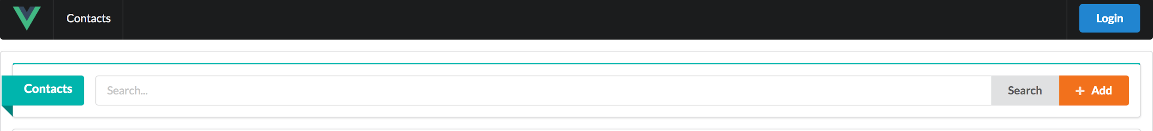
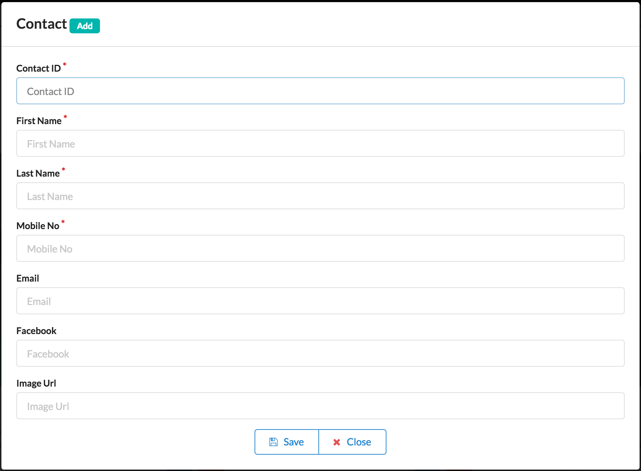
State Management with VueX
ContactEditor
Clicked Add
Open Contact Editor
Set Mode is Add
Set contact model is blank value

Slide 52
State Management with VueX
Create components/ContactEditor.vue
<template>
<div :id="modalId" class="ui modal">
<div class="header">Contact
<div class="ui teal horizontal label">{{mode}}</div>
</div>
<div class="content">
<form class="ui form" v-on:submit.prevent>
<div class="field required">
<label>Contact ID</label>
<input id="contactId" type="text" v-model="contact.id" placeholder="Contact ID">
</div>
<div class="field required">
<label>First Name</label>
<input id="firstName" type="text" v-model="contact.firstName" placeholder="First Name">
</div>
...
2

Slide 53
State Management with VueX
Create components/ContactEditor.vue
…
<div class="field required">
<label>Last Name</label>
<input id="lastName" type="text" v-model="contact.lastName" placeholder="Last Name">
</div>
<div class="field required">
<label>Mobile No</label>
<input id="mobileNo" type="text" v-model="contact.mobileNo" placeholder="Mobile No">
</div>
<div class="field">
<label>Email</label>
<input id="email" type="email" v-model="contact.email" placeholder="Email">
</div>
...
2
3

Slide 54
State Management with VueX
Create components/ContactEditor.vue
…
<div class="field">
<label>Facebook</label>
<input id="facebook" type="text" v-model="contact.facebook" placeholder="Facebook">
</div>
<div class="field">
<label>Image Url</label>
<input id="imageUrl" type="text" v-model="contact.imageUrl" placeholder="Image Url">
</div>
<div class="ui buttons center aligned container">
<button class="ui primary basic button" @click="onSaveClicked"><i class="save icon"></i>Save</button>
<button class="ui primary basic button" @click="onCloseClicked"><i class="close red icon"></i>Close</button>
...
3
4

Slide 55
State Management with VueX
Create components/ContactEditor.vue
…
</div>
<div class="ui error message transition hidden">
</div>
</form>
</div>
</div>
</template>
4

Slide 56
State Management with VueX
Create components/ContactEditor.vue
<script>
import $ from 'jquery'
export default {
name: 'contactEditor',
props: ['modalId', 'mode', 'contact'],
methods: {
onSaveClicked (e) {
this.$emit('onSaveClicked')
},
onCloseClicked () {
$('#' + this.modalId).modal('hide')
}
}
}
</script>

Slide 57
State Management with VueX
Add
components/SearchPanel.js
<template>
...
<div class="ui orange button" @click="onClickedAdd"> <i class="plus icon"></i>Add</div>
..
</template>
<script>
...
methods: {
onClickedAdd () {
this.$emit('onClickedAdd')
}
}
...
</script>

Slide 58
State Management with VueX
Add
pages/Contacts.vue
<template>
...
<searchpanel @onClickedAdd="openContactEditor('Add')"></searchpanel>
...

Slide 59
State Management with VueX
Add
pages/Contacts.vue
<script>
...
methods: {
...,
openContactEditor (mode) {
this.mode = mode
switch (mode) {
case 'Add':
this.contact = {}
$('#contactId').attr('disabled', false)
break
…
2

Slide 60
State Management with VueX
Add
pages/Contacts.vue
…
case 'Edit':
$('#contactId').attr('disabled', true)
break
}
$('.ui.error.message').transition('hide')
$('.ui.modal').modal('show')
},
2

Slide 61
State Management with VueX
Add
pages/Contacts.vue
<template>
...
<contactEditor modalId="contactModal" :contact="contact" :mode="mode" @onSaveClicked="validateContact"></contactEditor>
<script>
…
methods: {
…
validateContact () {
$('.ui.form').form(this.validateRule)
}
...

Slide 62
State Management with VueX
Add
pages/Contacts.vue
data () {
return {
...
validateRule: {
fields: {
contactId: {
identifier: 'contactId',
rules: [{
type: 'empty',
prompt: 'Please enter Contact ID!'
}]
},
...
...
firstName: {
identifier: 'firstName',
rules: [{
type: 'empty',
prompt: 'Please enter First Name!'
}]
},
lastName: {
identifier: 'lastName',
rules: [{
type: 'empty',
prompt: 'Please enter Last Name!'
}]
},
...
2
2
3

Slide 63
State Management with VueX
Add
pages/Contacts.vue
mobileNo: {
identifier: 'mobileNo',
rules: [{
type: 'empty',
prompt: 'Please enter Mobile No!'
}]
}
},
...
...
onFailure: (formErrors, fields) => {
$('.ui.error.message').transition('show')
},
onSuccess: () => {
this.saveContact(this.mode)
$('.ui.modal').modal('hide')
}
}
4
4

Slide 64
State Management with VueX
Add
pages/Contacts.vue
methods: {
addContact () {
contactsStore.dispatch('addContact', this.contact)
.then(() => {
this.contacts = contactsStore.getters.contacts
})
},
editContact () {
contactsStore.dispatch('updateContact', this.contact)
.then(() => {
this.contacts = contactsStore.getters.contacts
})
},
....
...
saveContact (mode) {
switch (mode) {
case 'Add':
this.addContact()
break
case 'Edit':
this.editContact()
break
}
}
2
2

Slide 65
State Management with VueX
Update, Remove
components/CardItem.js
methods: {
...,
onEditClicked () {
this.$emit('onEditClicked', this.item)
},
onRemoveClicked () {
this.$emit('onRemoveClicked', this.item)
}
}

Slide 66
State Management with VueX
Update, Remove
components/CardItem.js
<template>
...
<div class="extra content">
<button class="ui icon blue button" @click="onEditClicked" >
<i class="edit icon"></i>
</button>
<button class="ui icon red button" @click="onRemoveClicked">
<i class="erase icon"></i>
</button>
</div>

Slide 67
State Management with VueX
Update, Remove
components/CardList.js
methods: {
onEditClicked (item) {
this.$emit('onEditClicked', item)
},
onRemoveClicked (item) {
this.$emit('onRemoveClicked', item)
}
}

Slide 68
State Management with VueX
Update, Remove
pages/Contacts.js
<template>
...
<cardlist :items="items" @onEditClicked="onEditClicked" @onRemoveClicked="onRemoveClicked"></cardlist>
methods: {
...
onEditClicked (item) {
this.contact = item
this.openContactEditor('Edit')
},
...
2

Slide 69
State Management with VueX
Update, Remove
pages/Contacts.js
...
onRemoveClicked (item) {
console.log('remove clicked')
contactsStore.dispatch('removeContact', item)
.then(() => {
this.contacts = contactsStore.getters.contacts
})
},
2

Slide 70
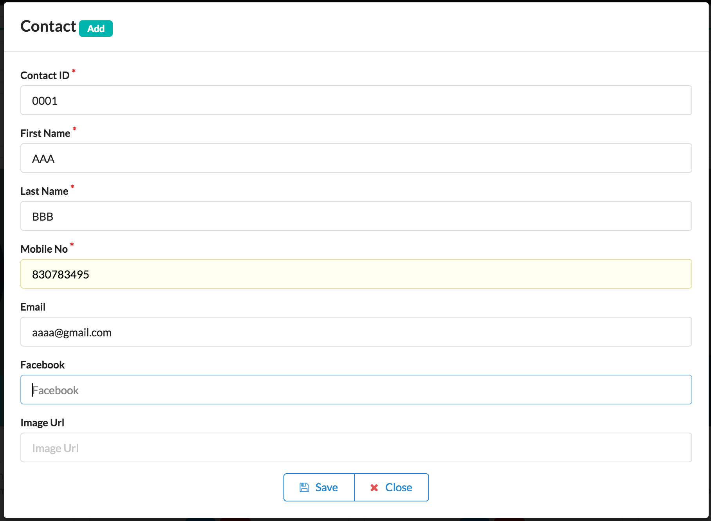
Integrate Rest Api for create data
On Save Clicked
Front End
localhost:8080
Back End
localhost:3000
MongoDB
Call post /contacts/add
Connect and insert data
Reply back to original
Response to server

Slide 71
Integrate Rest Api for create data
Create components/ModalMessage.vue
<template>
<div :id="modalId" class="ui modal success message">
<i class="close icon"></i>
<div>
<h3>{{headerTitle}} </h3>
</div>
<p >{{message}} </p>
</div>
</template>
<script>
export default {
name: 'modalmessage',
props: ['modalId', 'headerTitle', 'message']
}
</script>

Slide 72
Integrate Rest Api for create data
Create api/Contacts.js
import axios from 'axios'
export default {
add: (data) => {
let url = 'http://localhost:3000/contacts/add'
return axios.post(url, data)
}
}

Slide 73
Integrate Rest Api for create data
Modify pages/Contacts.js
methods: {
...
showMessage (action, status, unhandleMsg) {
let MODAL_MESSAGE_ID = '#modalMessage'
this.headerTitle = status
switch (status) {
case 'Success':
$(MODAL_MESSAGE_ID).removeClass('error message')
$(MODAL_MESSAGE_ID).addClass('success message')
this.message = `${action} successfully.`
break
...
...
case 'Error':
$(MODAL_MESSAGE_ID).removeClass('success message')
$(MODAL_MESSAGE_ID).addClass('error message')
this.message = `${action} ${unhandleMsg}`
break
}
$('#modalMessage').modal('show')
},
2
2

Slide 74
Integrate Rest Api for create data
Modify pages/Contacts.js
methods: {
...
addContact () {
contactsApi.add(this.contact)
.then((result) => {
if (result.status === 200 && result.data.ok === 1) {
this.showMessage('Insert', 'Success')
} else {
this.showMessage('Insert', 'Error', result.statusText)
}
}).catch((result) => {
this.showMessage('Insert', 'Error', JSON.stringify(result))
})
}

Slide 75
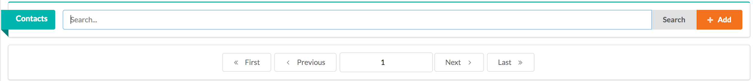
Integrate Rest Api for find data
On Search Clicked
Front End
localhost:8080
Back End
localhost:3000
MongoDB
Call post /contacts/get
Connect and find data
Reply back to original
Response to server

Slide 76
Integrate Rest Api for find data
Modify /serverapi.js
app.post('/contacts/getMany', function(req, res){
var pageSize = 2;
var currentPage = 1 , skip = 0;
if (req.body.currentPage) {
currentPage = req.body.currentPage;
}
skip = (currentPage - 1) * pageSize;
condition = req.body.condition;
co = require('co');
...
2

Slide 77
Integrate Rest Api for find data
Modify /serverapi.js
...
co(function*() {
var db = yield MongoClient.connect(dbUrl);
var collection = db.collection("contacts");
var totalItems = yield collection.count(condition);
var result = yield collection.find(condition).skip(skip).limit(pageSize).toArray();
var totalPages = Math.ceil(totalItems / pageSize);
res.send({totalPages:totalPages, result:result})
db.close();
})
})
2

Slide 78
Integrate Rest Api for find data
Modify /api/Contacts.js
...
get: (condition) => {
let url = 'http://localhost:3000/contacts/getMany'
return axios.post(url, condition)
}

Slide 79
Integrate Rest Api for find data
Modify components/SearchPanel.vue
<template>
...
<input type="text" v-model="textSearch" placeholder="Search...">
<div class="ui button" @click="onSearchClicked">Search</div>
...
<script>
...
data () {
...
textSearch: ''
...
methods: {
...
onSearchClicked () {
this.$emit('onSearchClicked', this.textSearch)
}

Slide 80
Integrate Rest Api for find data
Modify components/DataPager.vue
<template> ...
<button class="ui basic button" @click="onFirstClicked">
<i class="angle double left icon"></i> First
</button>
<button class="ui basic button" @click="onPrevClicked">
<i class="angle left icon"></i> Previous
</button>
<div class="ui input">
<input type="number" v-model="currentPage" class="ui center aligned segment" readonly></input>
</div>
<button class="ui basic button" @click="onNextClicked"> Next
<i class="angle right icon"></i>
</button>
<button class="ui basic button" @click="onLastClicked"> Last
<i class="angle double right icon"></i>
</button>

Slide 81
Integrate Rest Api for find data
Modify components/DataPager.vue
<script>
...
props: ['currentPage'],
methods: { ...
onFirstClicked () {
this.$emit('onFirstClicked')
},
onPrevClicked () {
this.$emit('onPrevClicked')
},
onNextClicked () {
this.$emit('onNextClicked')
},
onLastClicked () {
this.$emit('onLastClicked')
}

Slide 82
Integrate Rest Api for find data
Modify stores/Contact.js
state: {
...
pager: {
pageSize: 2,
currentPage: 1,
totalPages: 0
},

Slide 83
Integrate Rest Api for find data
Modify stores/Contact.js
state: {
...
pager: {
pageSize: 2,
currentPage: 1,
totalPages: 0
},
...
getters: {
contacts: state => state.contacts,
currentPage: state => state.pager.currentPage,
totalPages: state => state.pager.totalPages
},

Slide 84
Integrate Rest Api for find data
Modify stores/Contact.js
mutations: { ...
SET_CONTACTS (state, contacts) {
state.contacts = contacts
},
SET_CURRENT_PAGE (state, page) {
if (page > state.pager.totalPages) {
state.pager.currentPage = state.pager.totalPages
} else if (page <= 0) {
state.pager.currentPage = 1
} else {
state.pager.currentPage = page
}
},
SET_TOTAL_PAGES (state, total) {
state.pager.totalPages = total
}

Slide 85
Integrate Rest Api for find data
Modify stores/Contact.js
actions: {
...
setContacts ({commit}, contacts) {
commit('SET_CONTACTS', contacts)
},
setCurrentPage ({commit}, page) {
commit('SET_CURRENT_PAGE', page)
},
setTotalPages ({commit}, total) {
commit('SET_TOTAL_PAGES', total)
}
}

Slide 86
Integrate Rest Api for find data
Modify pages/Contacts.vue
<template>
<div class="ui center aligned segment">
<searchpanel @onClickedAdd="openContactEditor('Add')" @onSearchClicked="onSearchClicked"></searchpanel>
<datapager :currentPage="getCurrentPage" @onFirstClicked="onFirstClicked" @onPrevClicked="onPrevClicked" @onNextClicked="onNextClicked" @onLastClicked="onLastClicked"></datapager>
<div class ="ui center aligned segment">
<cardlist :items="getContactList" @onEditClicked="onEditClicked" @onRemoveClicked="onRemoveClicked"></cardlist>
<contactEditor modalId="contactModal" :contact="contact" :mode="mode" @onSaveClicked="validateContact"></contactEditor>
</div>

Slide 87
Integrate Rest Api for find data
Modify pages/Contacts.vue
...
mounted () {
this.getContact({condition: {}})
},
computed: {
getCurrentPage () {
return contactsStore.getters.currentPage
},
getContactList () {
return contactsStore.getters.contacts
}
},

Slide 88
Integrate Rest Api for find data
Modify pages/Contacts.vue
data () {
...
currentPage: 1,
textSearch: '',
...
methods: {
addContact () {
contactsApi.add(this.contact)
.then((result) => {
if (result.status === 200 && result.data.ok === 1) {
this.showMessage('Insert', 'Success')
contactsStore.dispatch('setCurrentPage', 1)
...

Slide 89
Integrate Rest Api for find data
Modify pages/Contacts.vue
methods: {
...
getContact (condition) {
contactsApi.get(condition)
.then((result) => {
if (result.status === 200) {
contactsStore.dispatch('setContacts', result.data.result)
contactsStore.dispatch('setTotalPages', result.data.totalPages)
}
})
},

Slide 90
Integrate Rest Api for find data
Modify pages/Contacts.vue
methods: {
...
getSearchCondition () {
var condition = {}
if (this.textSearch.length > 0) {
condition.condition = {'$or': [
{'id': {'$regex': `.*${this.textSearch}.*`}},
{'firstName': {'$regex': `.*${this.textSearch}.*`}},
{'lastName': {'$regex': `.*${this.textSearch}.*`}}
]
}
}
return condition
},

Slide 91
Integrate Rest Api for find data
Modify pages/Contacts.vue
methods: {
...
onFirstClicked () {
contactsStore.dispatch('setCurrentPage', 1)
},
onPrevClicked () {
contactsStore.dispatch('setCurrentPage', contactsStore.getters.currentPage - 1)
},
onNextClicked () {
contactsStore.dispatch('setCurrentPage', contactsStore.getters.currentPage + 1)
},
onLastClicked () {
contactsStore.dispatch('setCurrentPage', contactsStore.getters.totalPages)
},

Slide 92
Integrate Rest Api for find data
Modify pages/Contacts.vue
methods: {
...
onSearchClicked (textSearch) {
this.textSearch = textSearch
var condition = this.getSearchCondition()
this.getContact(condition)
},
...
watch: {
getCurrentPage: function (val) {
var condition = this.getSearchCondition()
condition.currentPage = val
this.getContact(condition)
}
}

Slide 93
Integrate Rest Api for find data
Search Button
Pages/Contacts
Stores/Contacts
api/Contacts
Rest Api
MongoDB
onSearchClicked
getSearchCondition
getContact
get
/contacts/getMany
res.send
db.contacts.find
contactsStore.dispatch('setContacts'
contactsStore.dispatch('setTotalPages'

Slide 94
Integrate Rest Api for update and remove data
Modify api/Contacts.vue
…
update: (condition) => {
let url = 'http://localhost:3000/contacts/update'
return axios.put(url, condition)
},
remove: (condition) => {
console.log('remove', condition)
let url = 'http://localhost:3000/contacts/delete'
return axios.delete(url, {'data': condition})
}

Slide 95
Integrate Rest Api for update and remove data
Add components/ConfirmModal.vue
<template>
<div :id="id" class="ui modal">
<div class="header">{{header}}</div>
<div class="content">
<p> <i :class="icon"></i> {{message}}</p>
</div>
<div class="actions">
<div class="ui youtube button" @click="onOKClicked">OK</div>
<div class="ui cancel button" @click="onCancelClicked">Cancel</div>
</div>
</div>
</template>
...
2

Slide 96
Integrate Rest Api for update and remove data
Add components/ConfirmModal.vue
...
<script>
export default {
name: 'confirmmodal',
props: ['header', 'message', 'icon', 'id'],
methods: {
onOKClicked: function () {
this.$emit('onOKClicked', this)
},
onCancelClicked: function () {
this.$emit('onCancelClicked', this)
}
}
}
</script>
2

Slide 97
Integrate Rest Api for update and remove data
Modify pages/Contacts.vue
<template>
...
<confirm-modal id="confirmModal" header="Deleting" :message="msgDelete" @onOKClicked="onOKClicked" ></confirm-modal>
...
</template>
<script>
...
import ConfirmModal from '@/components/ConfirmModal'
export default {
name: 'contacts',
components: {searchpanel, datapager, cardlist, contactEditor, modalmessage, ConfirmModal},

Slide 98
Integrate Rest Api for update and remove data
Modify pages/Contacts.vue
data () {
return {
...
msgDelete: '',
...
addContact () {
contactsApi.add(this.contact)
.then((result) => {
if (result.status === 200 && result.data.ok === 1) {
this.showMessage('Insert', 'Success')
this.getContact({condition: {}})

Slide 99
Integrate Rest Api for update and remove data
Modify pages/Contacts.vue
editContact () {
var data = this.contact
delete data['_id']
var condition = {'criteria': {'_id': this.contact['_id']}, 'data': {'$set': data}}
contactsApi.update(condition)
.then((result) => {
if (result.status === 200 && result.data.ok === 1) {
this.showMessage('Update', 'Success')
this.getContact({condition: {}})
contactsStore.dispatch('setCurrentPage', 1)
} else {
this.showMessage('Update', 'Error', result.statusText)
}
}).catch((result) => {
this.showMessage('Update', 'Error', JSON.stringify(result))
})
},

Slide 100
Integrate Rest Api for update and remove data
Modify pages/Contacts.vue
getSearchCondition () {
var condition = {condition: {}}
if (this.textSearch.length > 0) {
condition.condition = {'$or': [
{'id': {'$regex': `.*${this.textSearch}.*`}},
{'firstName': {'$regex': `.*${this.textSearch}.*`}},
{'lastName': {'$regex': `.*${this.textSearch}.*`}}
]
}
}
return condition
}

Slide 101
Integrate Rest Api for update and remove data
Modify pages/Contacts.vue
onRemoveClicked (item) {
this.contact = item
this.msgDelete = `Are you sure to delete contact of ${this.contact.firstName + ' ' + this.contact.lastName} [y/n] ?`
$('#confirmModal').modal('show')
},

Slide 102
Integrate Rest Api for update and remove data
Modify pages/Contacts.vue
onOKClicked () {
var condition = {'id': this.contact.id}
$('#confirmModal').modal('hide')
contactsApi.remove(condition)
.then((result) => {
if (result.status === 200 && result.data.ok === 1) {
this.showMessage('Delete', 'Success')
this.contact = {}
contactsStore.dispatch('setCurrentPage', 1)
this.getContact({condition: {}})
} else {
this.showMessage('Delete', 'Error', result.statusText)
}
}).catch((result) => {
this.showMessage('Delete', 'Error', JSON.stringify(result))
})
},

Slide 103
Integrate Rest Api for update and remove data
Modify pages/Contacts.vue
watch: {
getCurrentPage: function (val) {
var condition = this.getSearchCondition()
condition.currentPage = (val < 1 ? 1 : val)
this.getContact(condition)
}
}

Slide 104
Integrate Rest Api for update and remove data
Edit Button
Pages/Contacts
Stores/Contacts
api/Contacts
Rest Api
MongoDB
onEditClicked
openContactEditor
update
/contacts/update
onSaveClicked
res.send
db.contacts.update
getContact
contactsStore.dispatch('setCurrentPages

Slide 105
Integrate Rest Api for update and remove data
Delete Button
Pages/Contacts
Stores/Contacts
api/Contacts
Rest Api
MongoDB
onRemoveClicked
openConfirmModal
remove
/contacts/delete
onOKClicked
res.send
db.contacts.delete
contactsStore.dispatch('setCurrentPages
getContact

Slide 106
Integrate Basic Security
MongoDB
Create User for authentication.
Create Timelive index to keep session logged in.
Stop Mongo database and restart with authentication mode.
db.createUser(
{
user: "apaichon",
pwd: "passw0rd",
roles: [ "readWrite", "dbAdmin" ]
}
)
db.loginSession.createIndex({"logon":1},{"expireAfterSeconds":300})
./mongod --dbpath '<dbpath>' --auth
1
2
3

Slide 107
Integrate Basic Security
MongoDB
Create User for authentication.
Create Timelive index to keep session logged in.
Stop Mongo database and restart with authentication mode.
db.createUser(
{
user: "apaichon",
pwd: "passw0rd",
roles: [ "readWrite", "dbAdmin" ]
}
)
db.loginSession.createIndex({"logon":1},{"expireAfterSeconds":300})
./mongod --dbpath '<dbpath>' --auth
1
2
3

